Slide 1
The Severe Weather Data Inventory (SWDI): A Geospatial Database and Climatology of Severe Weather Data
Steve Ansari, Stephen Del Greco (NOAA / NCDC)
Mark Phillips (UNC-Asheville / NEMAC)

Slide 2
Goals
Easy access to data in NCDC Archive
Inventory for Severe Weather Data
Derive climatology products
Historical context for events
Geospatial Database solution
Services! SOA!

Slide 3
Data
Current Datasets:
NEXRAD Level-III Storm Attributes
Preliminary Local Storm Reports
National Lightning Detection Network
Coming soon:
NWS Warnings, Storm Events Database, Hurricane Tracks, Drought Monitor
Framework for other datasets

Slide 4
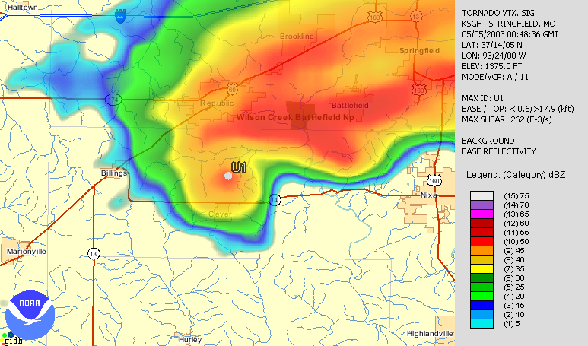
Data
NEXRAD Level-III TVS Product (w/ Reflectivity)

Slide 5
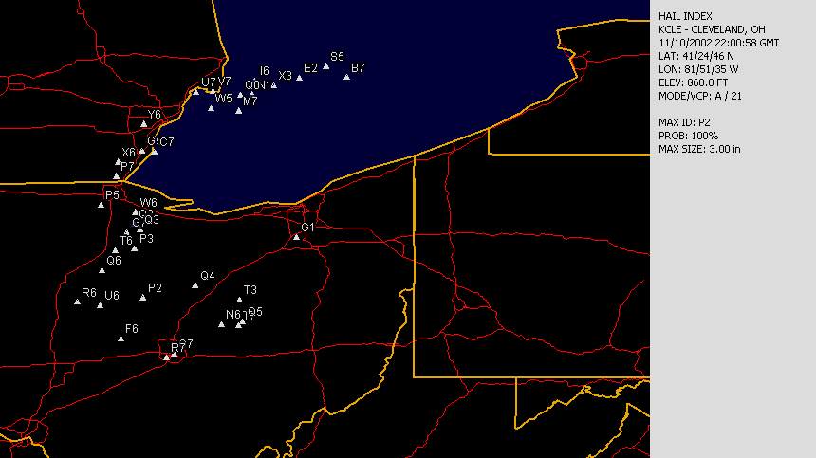
Data
NEXRAD Level-III Hail Product

Slide 6
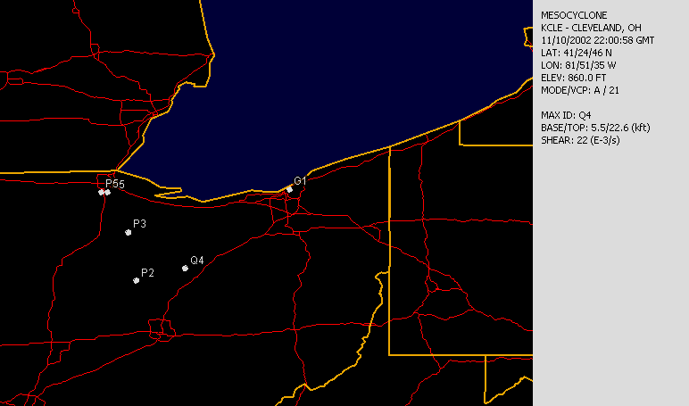
Data
NEXRAD Level-III Mesocyclone Product

Slide 7
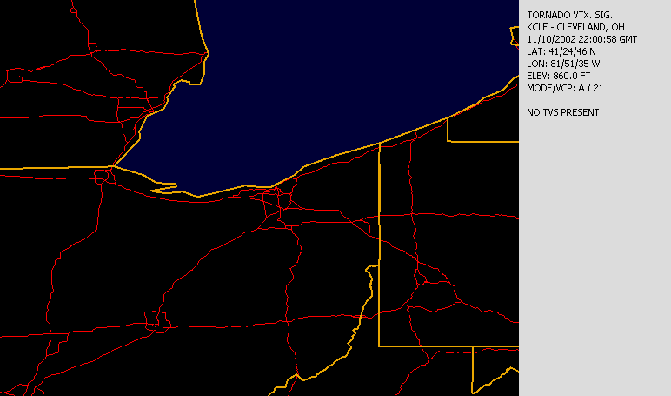
Data
NEXRAD Level-III Tornado Product

Slide 8
Data
Preliminary Local Storm Reports
Preliminary reports from Storm Spotters, Emergency Mgmt., etc…
Tornado, Hail, Flash Flood, Wind, etc…
Transmitted in real-time – nightly load into SWDI

Slide 9
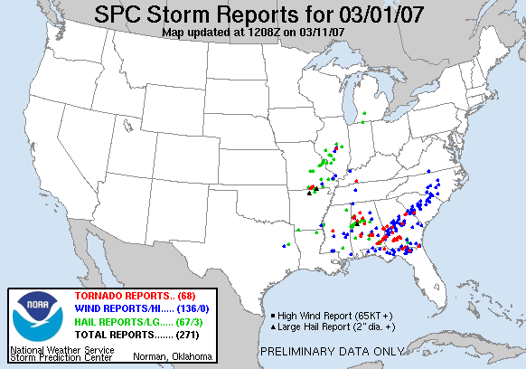
Data
Preliminary Local Storm Reports

Slide 10
Data
NCDC Storm Events Database
Verified text reports from NWS and Storm Prediction Center.
Data from 1950 – Present
Tornado, Hail, Lightning, Wind, etc…
Fatalities, Injuries, Crop/Property Damage
Loaded into SWDI ~3 months after end of each month

Slide 11
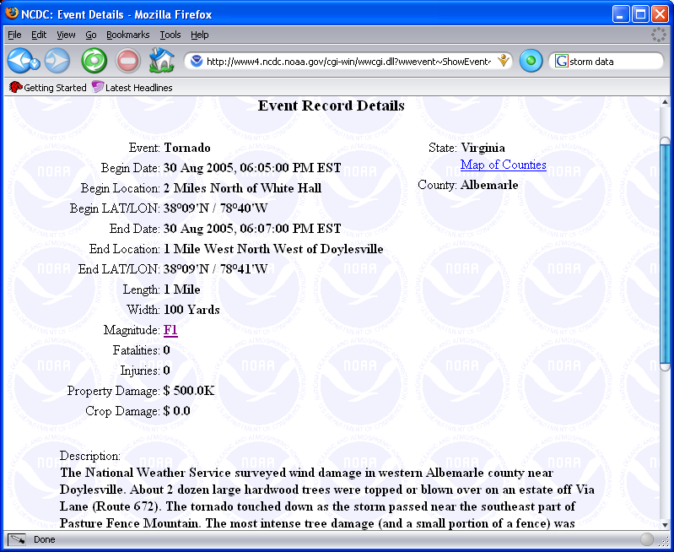
Data
NCDC Storm Events Database

Slide 12
Data
NWS Warnings (polygon and county-based)
Severe Thunderstorm
Tornado
Flash Flood
Marine

Slide 13
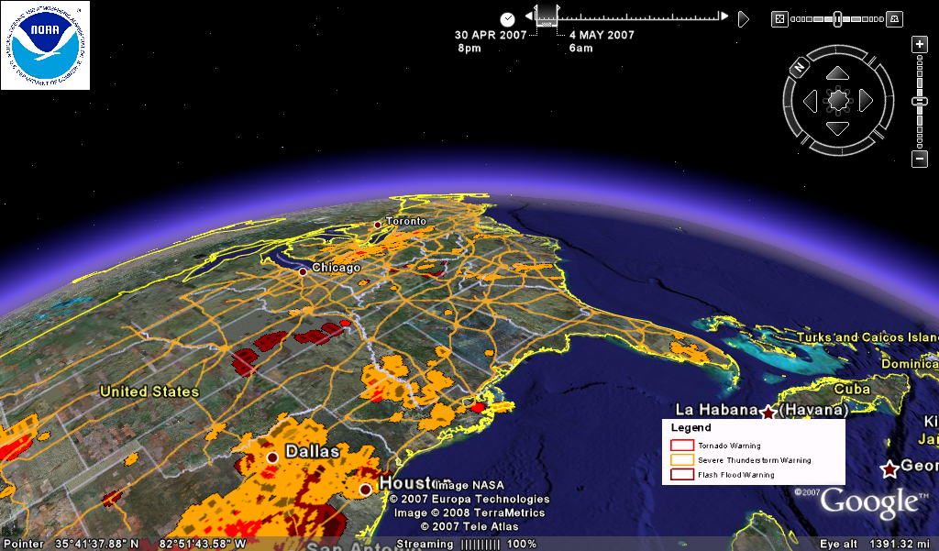
Data
NWS Warnings in Google Earth

Slide 14
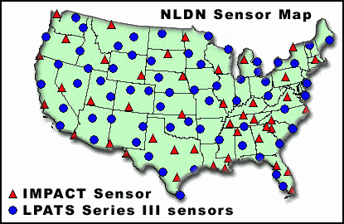
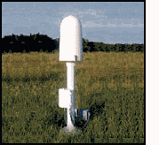
Data
Vaisala’s National Lightning Detection Network (NLDN)
130 Sensors Nationwide, 1987 – Present
Raw data: .gov/.mil ONLY
Images courtesy of NASA (http://thunder.msfc.nasa.gov/primer/primer3.html)

Slide 15
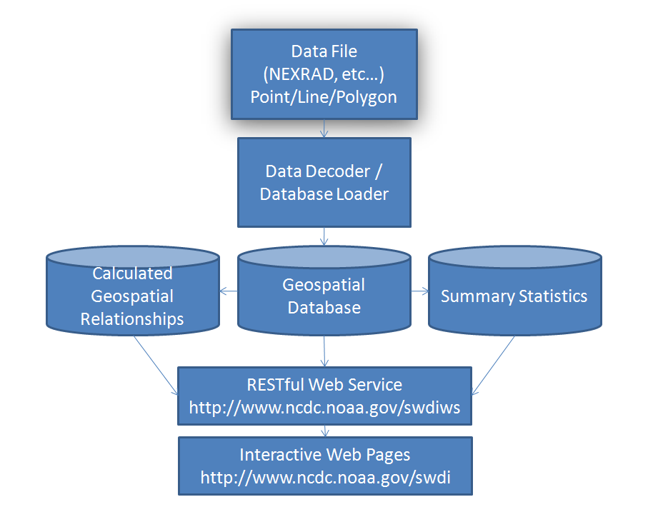
Process

Slide 16
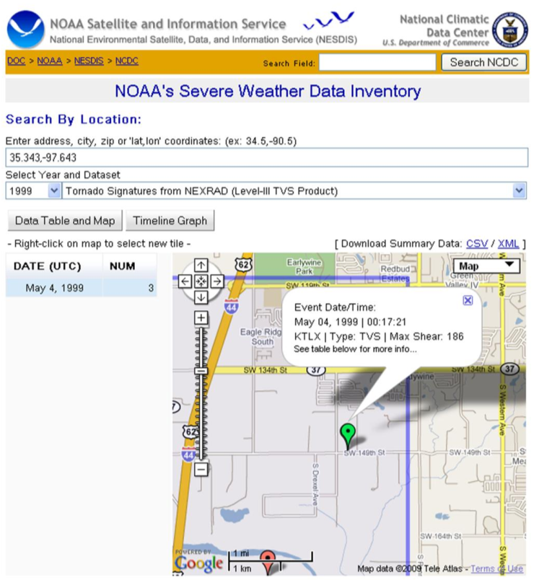
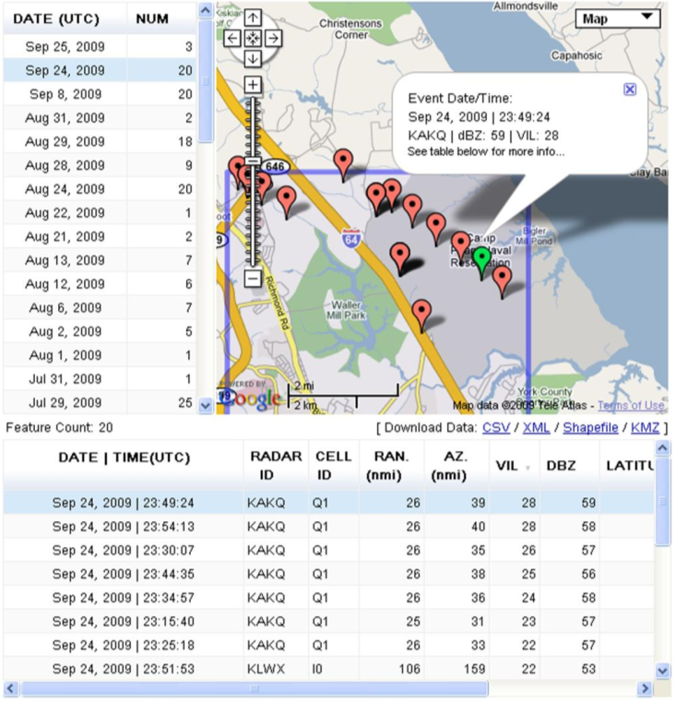
Access
Web Pages ( http://www.ncdc.noaa.gov/swdi )

Slide 17
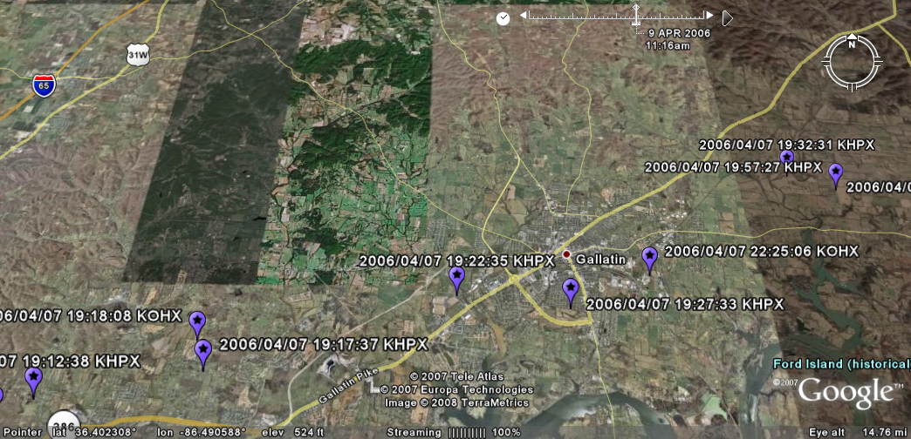
Access
Data Download (Shapefile, KMZ, Text File)
NEXRAD Tornado Vortex Signatures in Google Earth

Slide 18
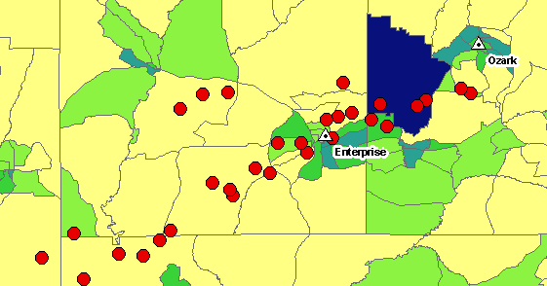
Access
Data Download (Shapefile, KMZ, CSV, XML)
Example GIS analysis with NEXRAD TVS and census data:

Slide 19
Access
FTP: CSV Text files of all SWDI Data
ftp://ftp.ncdc.noaa.gov/pub/data/swdi
REST Web Services
Each URL defines a unique resource
Easy programmatic access to data
Allows integration into custom applications
System and language independent

Slide 20
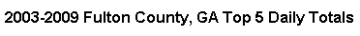
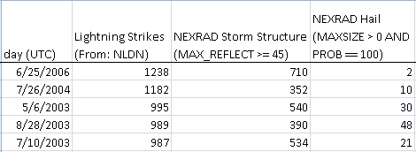
Reports
Counts by Day per county.
BETA version for Lightning, NEXRAD Storm Cells, NEXRAD Hail, TVS:
ftp://ftp.ncdc.noaa.gov/pub/data/swdi/reports

Slide 21
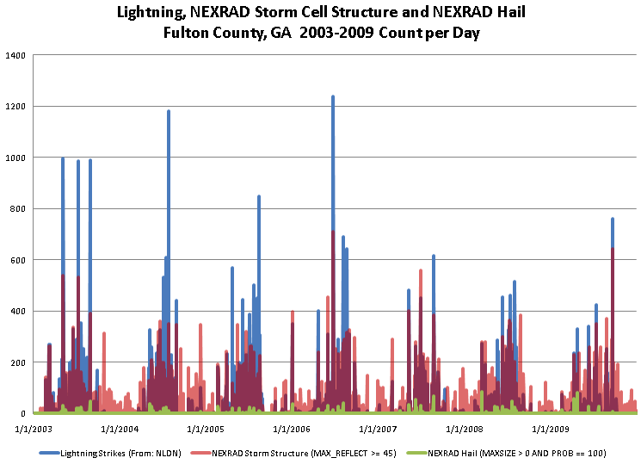
Reports

Slide 22
Analysis
Comparison between datasets
Possible Bias Detection, QC, etc…
“Select all TVS that are NOT within 10 miles and 15 minutes of a Severe Thunderstorm or Tornado Warning”
“Select all Thunderstorm Warnings that do not contain a Local Storm Report”

Slide 23
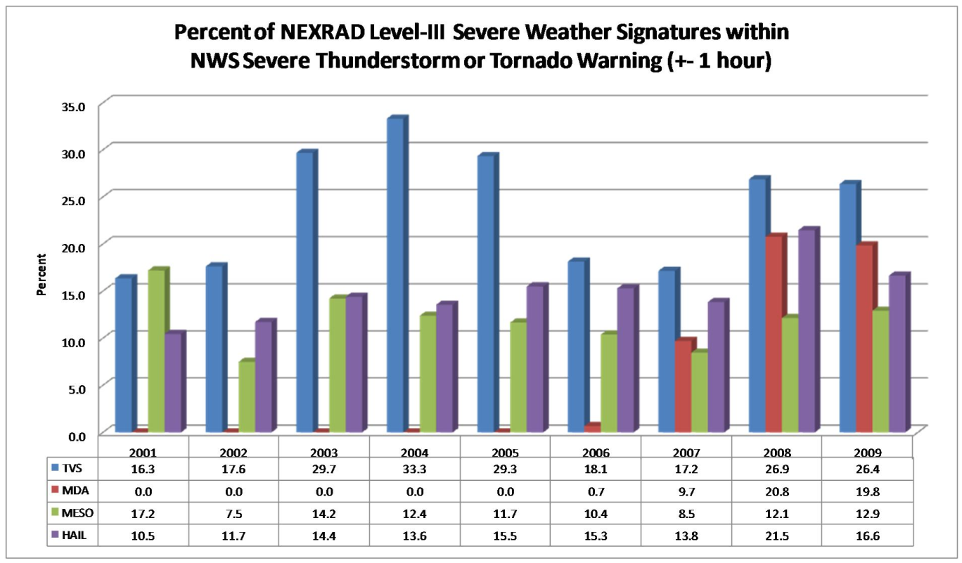
Analysis

Slide 24
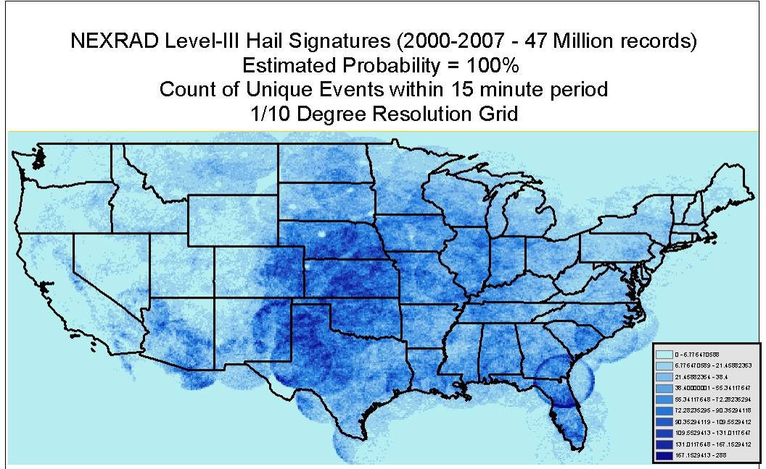
Analysis

Slide 25
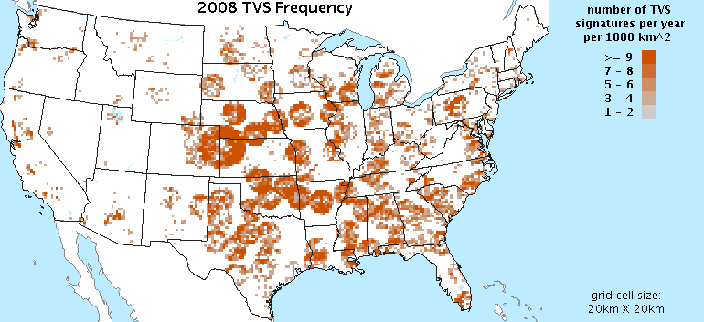
Data Quality
Climatology grids produced for each product.
Artifacts, bias and other issues apparent.

Slide 26
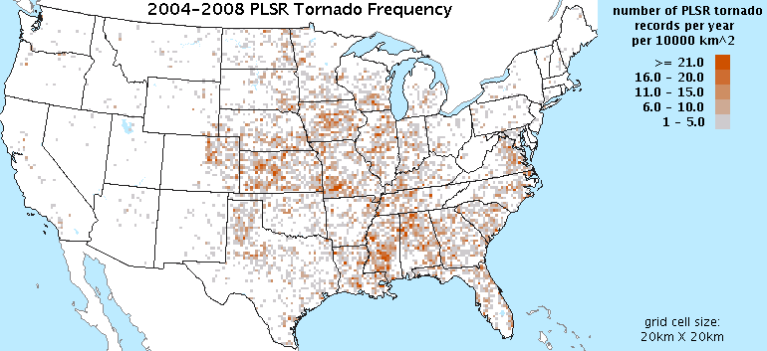
Data Quality
Climatology grids produced for each product.
Artifacts, bias and other issues apparent.

Slide 27
Conclusion
The Severe Weather Data Inventory:
Allows easier access to the NCDC Archive
Joint project with NEMAC, UNCA, RENCI
Modular GIS spatial database approach
Datasets remain independent
Multiple user access methods
Improve disaster response, recovery and mitigation
Many possibilities of application
Not real-time at NCDC – updated nightly

Slide 28
Questions for You
What additional datasets would be most useful?
We are planning on Hurricane Tracks, NCDC Storm Data, Drought Monitor and more.
What else?
Advice on conveying caveats of data to decision makers?

Slide 29
Contact
Thank you! Questions?
SWDI Website: http://www.ncdc.noaa.gov/swdi
Contact:
Steve.Ansari@noaa.gov
(828) 271-4611
151 Patton Ave.
Asheville, NC 28801

Slide 31
Analysis
Disaster Mitigation
Example:
Compare 1 Hour of NLDN to Population Grid
Data:
NLDN 08/02/2005 20:00 – 21:00 UTC
Gridded Population of the World - SEDAC (Socioeconomic Data and Applications Center at Columbia University)
http://sedac.ciesin.columbia.edu/gpw

Slide 32
Analysis
Example:
Compare 1 Hour of NLDN to Population Grid
Process:
1. Download 2000 Population Grid at
~4 km resolution.
2. Convert cell centroids to points
3. Subset data for Florida
4. Spatial Join to closest NLDN data
5. Examine matching population grid cells

Slide 33
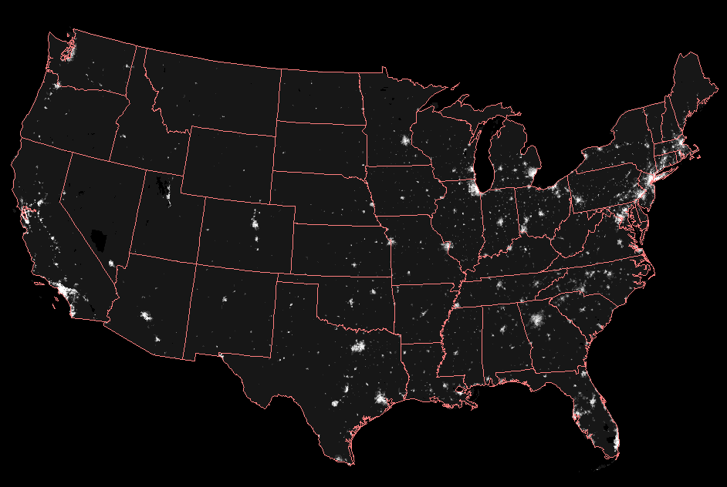
Example Analysis
Process: Download 2000 Population Grid (~12 km resolution).

Slide 34
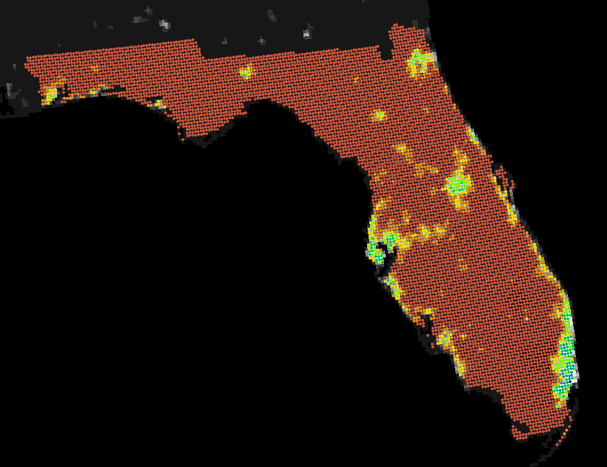
Example Analysis
Process: Convert cell centroids to points, subset for Florida.

Slide 35
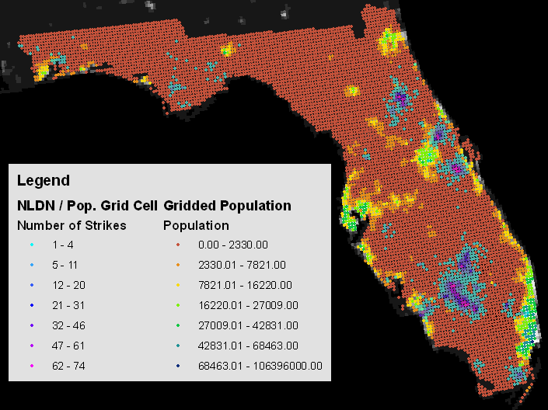
Example Analysis
Process: Spatially join to NLDN data based on distance.

Slide 36
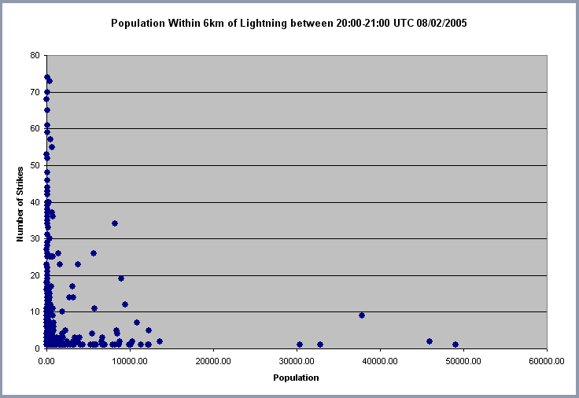
Example Analysis
Total Population Affected = 696,179 --- 5 Strikes or More = 166,346

